Slide 1

A gamified introduction to Python Programming Lecture 15 Dictionaries and Object-Oriented Thinking
Matthieu DE MARI – Singapore University of Technology and Design

Slide 2

Outline (Chapter 15)
What is the tuple type? (fast version)
What is the dictionary type?
What are typical operations on dictionaries?
How are dictionaries and the concept of object-oriented programming related?
What is “object-oriented thinking”?
Practice on dictionaries.
(If time allows, what is the set types?)

Slide 3
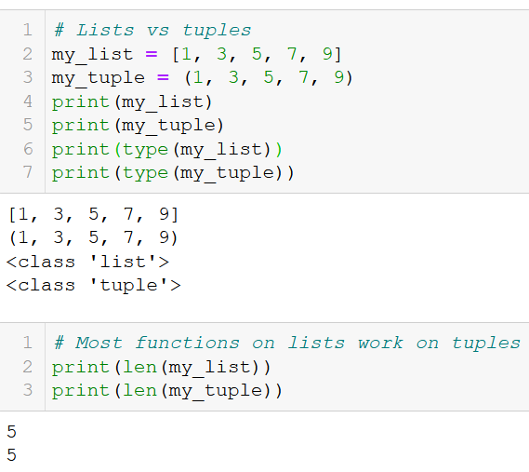
The tuple type
Definition (the tuple type):
Tuples are collections of variables, very similar to lists, but they have their elements listed between parentheses (), instead of square brackets [].
They share many functions with lists, such as the len() function for instance.
Tuples are indexed/accessed, sliced and traversed as in lists.

Slide 4
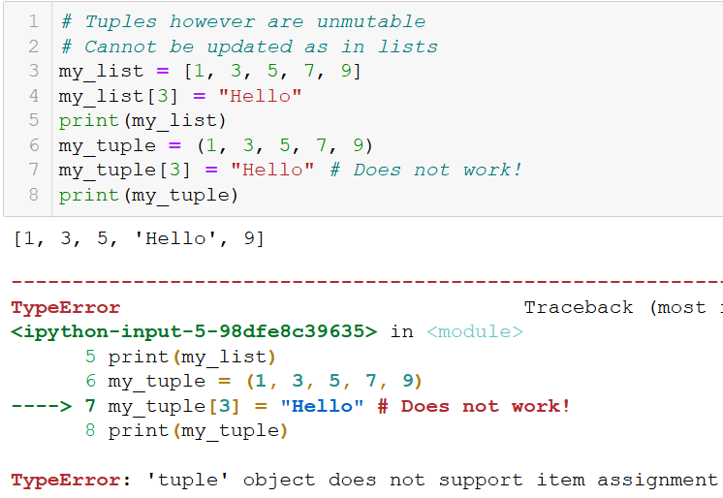
The tuple type
Definition (the tuple type):
Tuples are collections of variables, very similar to lists, but they have their elements listed between parentheses (), instead of square brackets [].
However, the difference between lists and tuples is that tuples, just like strings, are immutable.
→ Added practice on tuples (for those interested) in the extra practice folder on today’s materials!

Slide 5
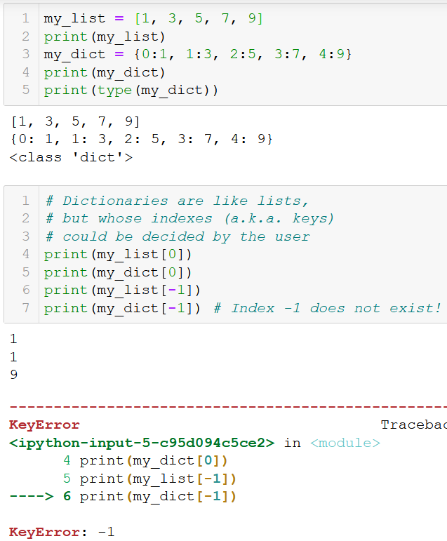
The dict type
Definition (the dictionary type):
Dictionaries (dict) are the last type of built-in variables we will cover during this course.
They operate as lists.
But they give the user the possibility to choose custom indexes/keys to use for elements instead of the default list values for positional indexes.

Slide 6
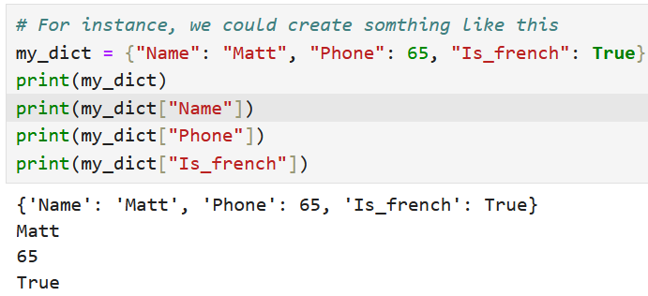
The dict type
Dictionaries (dict) operate as lists. But they give the user the possibility to choose custom indexes/keys to use for elements.
Indexes do not have to be integers, they could be strings, for instance.

Slide 7
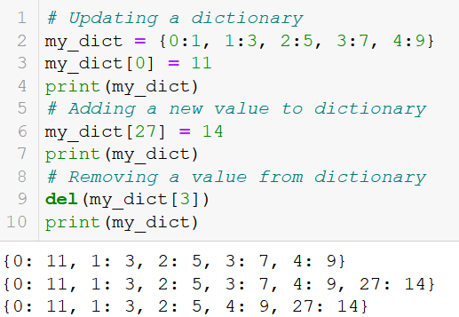
Adding, updating and removing elements
As with lists, we can update elements using the squared brackets [] notation.
During an update, If the key did not exist in the dictionary, it will add a new entry to the dictionary.
Otherwise, it will replace the current value assigned to this key.
As with lists, we can also remove an element from the dictionary with the del() function.

Slide 8
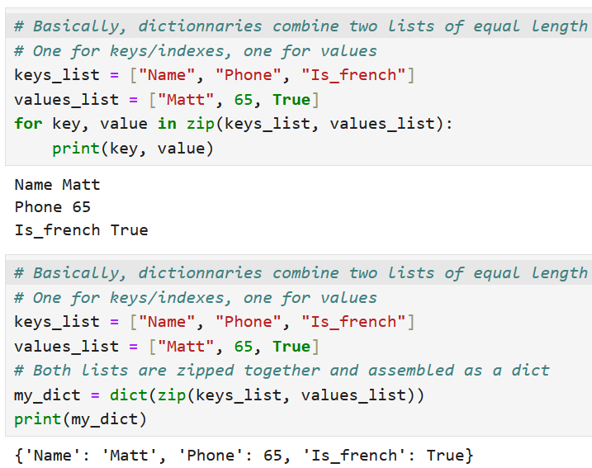
Defining dictionaries with zip
A dictionary simply consists of two lists with identical lengths:
One list of indexes/keys, used to refer to elements (replacing the list of positional indexes we can use to refer to the elements).
One list of values, assigned to each index/key.

Slide 9
Defining dictionaries with zip
A dictionary simply consists of two lists with identical lengths:
Dictionaries can be created with the zip() generator, which we used earlier to combine two lists of equal length in a for loop.
Turns out that if you have a list of keys and a list of values to assign to each of these keys, then you can use zip() to generate a dictionary easily!

Slide 10
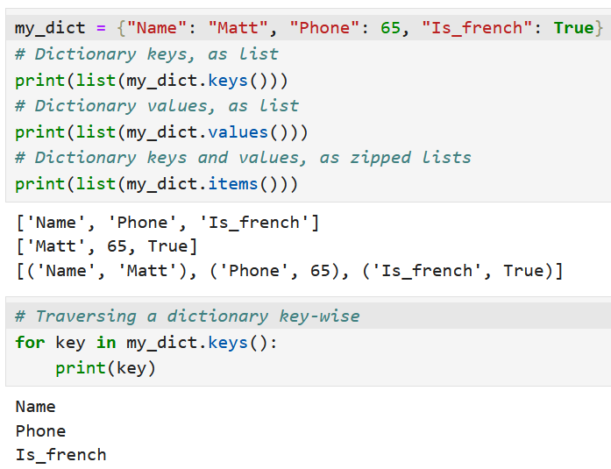
Keys, values and items in a dict
Once a dictionary is defined, we can retrieve
Its list of indexes/keys, using the keys() method,

Slide 11
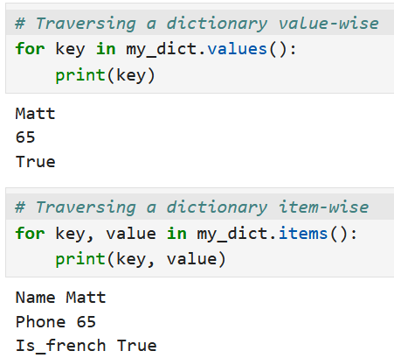
Keys, values and items in a dict
Once a dictionary is defined, we can retrieve
Its list of indexes/keys, using the keys() method,
Its list of values, using the values() method,

Slide 12
Keys, values and items in a dict
Once a dictionary is defined, we can retrieve
Its list of indexes/keys, using the keys() method,
Its list of values, using the values() method,
A list of all the possible of keys/indexes and values pairs, using the items() method.

Slide 13
Keys, values and items in a dict
Once a dictionary is defined, we can retrieve
Its list of indexes/keys, using the keys() method,
Its list of values, using the values() method,
A list of all the possible of keys/indexes and values pairs, using the items() method.
Note: all three methods give generators (as range, zip, enumerate, etc.).
Convert them to lists to visualize the values in these generators!

Slide 14
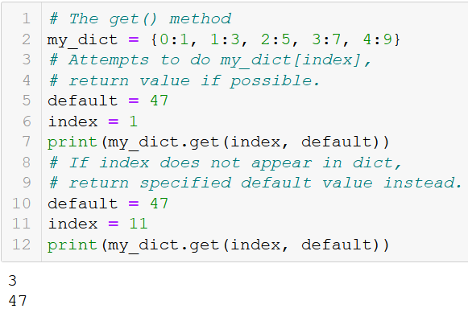
The get() method
Finally, dictionaries comes with a get() method, which receives two arguments.
The first argument is an index/key. The get() method attempts to retrieve the value in the dict for the given index/key.
If the index/key does not exist, it returns the default value specified as the second argument of get() instead.

Slide 15
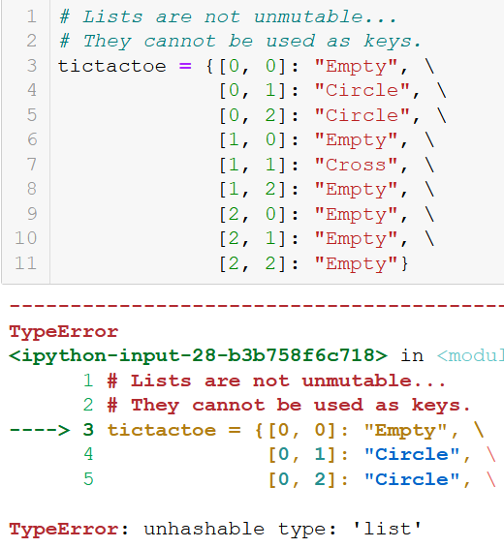
A note on keys
Important note on keys: The keys of a dictionary need to be immutable types of variables.
Immutables types: int, float, string, tuple, set, etc.
Mutable types: list, etc.
The dictionary on the right uses lists as keys (not acceptable!)

Slide 16
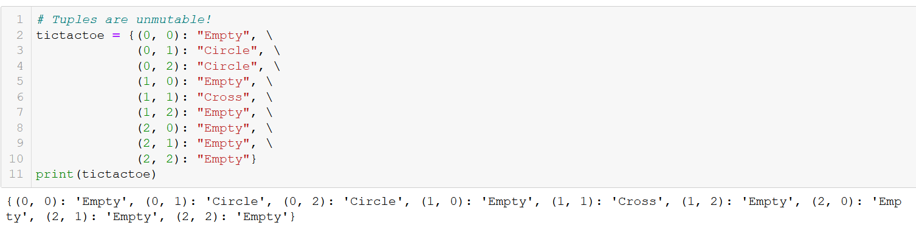
A note on keys
Important note on keys: The keys of a dict need to be immutable types of variables.
We can therefore make a dictionary if we use tuples as indexes/keys.

Slide 17
Matt’s Great advice
Matt’s Great Advice: Get comfortable with the dictionaries type.
Dictionaries are one of the most important types in Python.
While they might seem abstract at first, they are pretty easy to work with, especially if you understood the concepts behind lists.
Practice until you get comfortable with them, as we will be using them a lot!

Slide 18
Activity 1 - Find the missing card v2
Write a function find_missing_card(), which receives a deck, in variable deck, as its sole parameter.
The deck is a standard deck that has been shuffled and is missing a card. The function find_missing_card() should then return the one card that is missing in the deck, as a tuple.
Note that the deck is always missing a single card and will contain no duplicates.
Objective: try using a dictionary to count the number of hearts, spades, diamonds, clubs in deck. The one suit with a different number of cards is going to be the suit of the missing card!
suits_dict = {"Hearts": 12, "Spades": 13, "Diamonds": 13, "Clubs": 13}

Slide 19
Activity 2 - 1337 speak translators v2
You now know about dictionaries.
We will use a translation dictionary, defined below, whose keys are English characters and whose values are the numbers which should replace the said letter, when we translate English sentences into leet speak.
eng_leet_dict = {'I': '1', 'Z': '2', 'E': '3', 'A': '4',
'S': '5', 'T': '7', 'B': '8', 'O': '0’}
This translation dictionary should help you simplify your translation function drastically.

Slide 20
Activity 2 - 1337 speak translators v2
Your objective is then to write a second version of the function eng_to_leet_v2(), which receives two parameters:
the first one is eng_str, which corresponds to a sentence in English, written in capital letters,
the second one is the translation dictionary eng_leet_dict, defined earlier.
The function returns the equivalent sentence in leet speak, modifying the letters with numbers, by following the rules defined earlier.
The translation dictionary should help you simplify your function drastically.

Slide 21
Matt’s Great advice
Matt’s Great Advice: Everything around you can be described as an object.
Everything around us can be represented, in some way, as a dictionary with various attributes
Everything.
This approach is known as object-oriented programming. It conceptualizes all entities as collections of attributes, where each attribute is a key-value pair.
For instance, as a person, I have a name (str), an age (int), a birth year (int), etc.

Slide 22
Object oriented programming and thinking
Definition (Object-Oriented Programming): Object Oriented Programming (OOP) is a programming paradigm that relies on the concept of objects.
It is used to structure a software program into simple, reusable pieces of code/blueprints (usually called objects)
These are then used to create individual instances of self-contained objects.
This paradigm is an absolute game-changer, more to follow.
For now, I propose an introduction to OOP, called “Object Oriented Thinking”, which uses dictionaries instead.
Let us demonstrate with an example!

Slide 23
I believe this Object-Oriented Thinking calls for a demo…
Here is what happens in the mind of a programmer playing video games

Slide 24


Slide 25
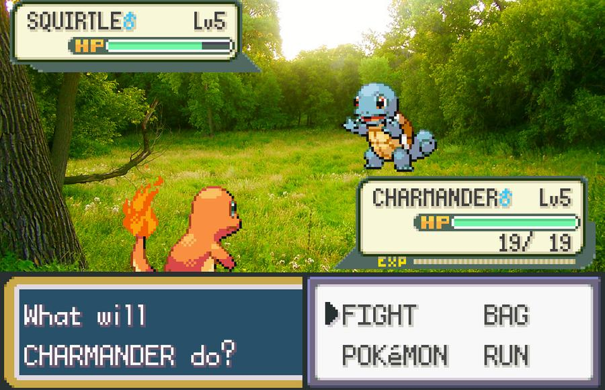

Slide 26
In the mind of a programmer…
Following the OOP paradigm, Pokemons can be viewed and described as programming objects, with several attributes, such as:
A name: as a string variable
A level: as an int
An elemental type: as a string variable
Some hitpoints (HP), strength and defense points.
Etc. (Surely you can come up with more ideas of attributes!)
Therefore, each Pokemon in the game could be described, by using a dictionary with several entries, following the same blueprint. Each Pokemon dictionary would have the same keys, but not necessarily the same values for each attribute (different names/stats).

Slide 27

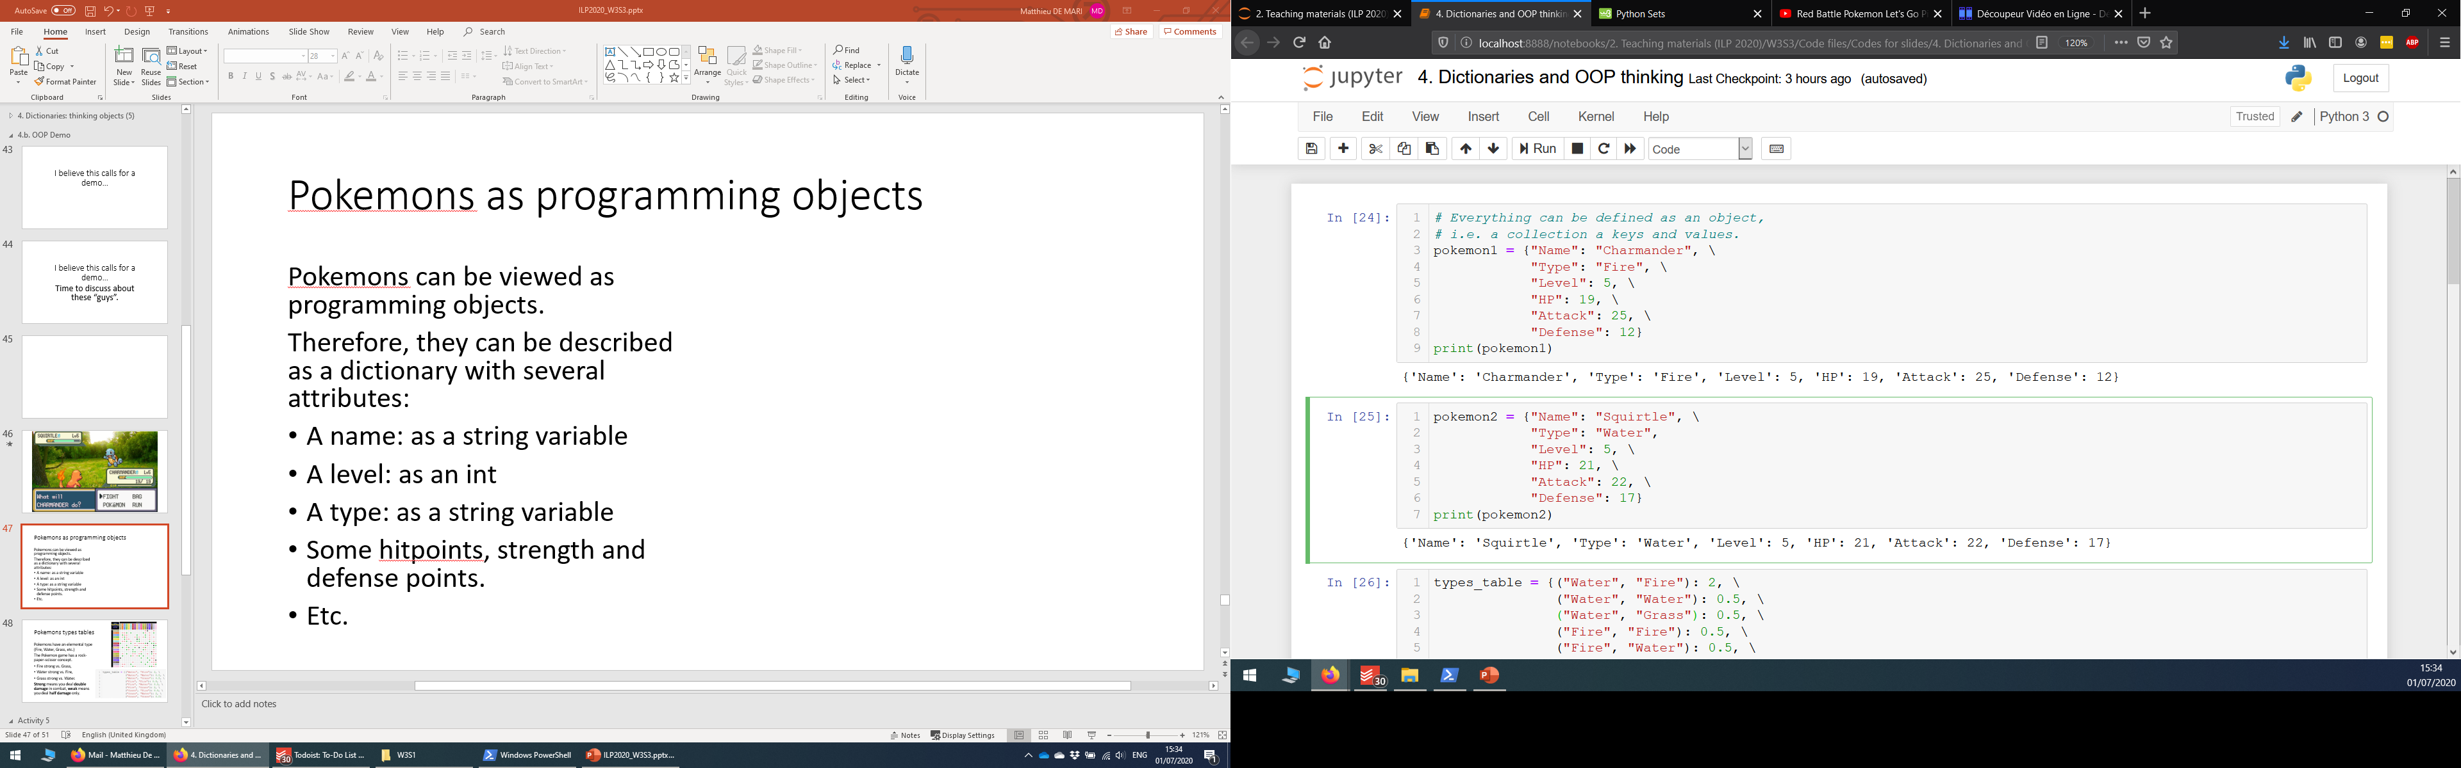
…Pokemons are programming objects!

Slide 28
…Pokemons are programming objects!
In fact, each Pokemon in the game could be described, by using a dictionary with several entries, following the same blueprint.
Each Pokemon dictionary would have the same keys, but not necessarily the same values assigned to each of these keys.
After all, the Pokemons could have different names and stats.
More concepts in the game could also be described using objects of some sort, such as (human character/player, items, environment objects, etc.)

Slide 29
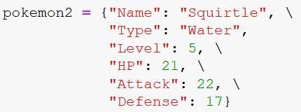

Slide 30
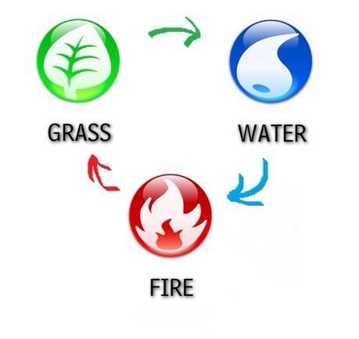
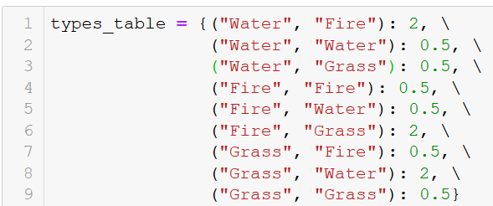
Pokemons types tables
Pokemons have an elemental type (Fire, Water, Grass, etc.)
The Pokemon game has a rock-paper-scissor concept.
Fire strong vs. Grass,
Water strong vs. Fire,
Grass strong vs. Water.
Strong means you deal double damage in combat, weak means you deal half damage only.

Slide 31
ATTACK!

Slide 32
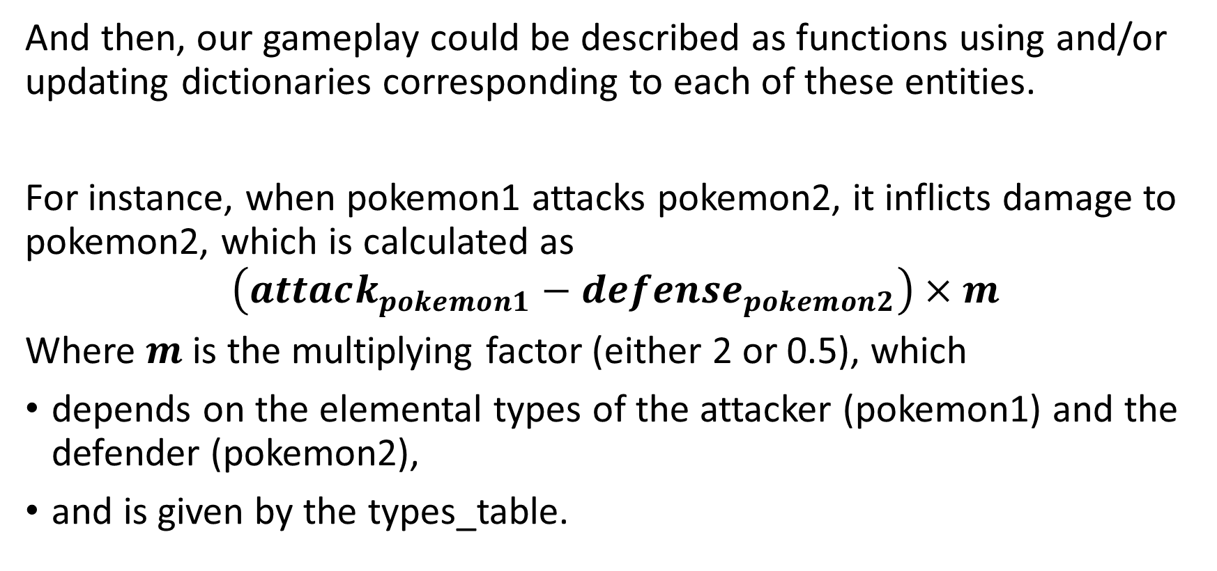
The attack function
And then, our gameplay could be described as functions using and/or updating dictionaries corresponding to each of these entities.
For instance, when pokemon1 attacks pokemon2, it inflicts damage to pokemon2, which is calculated as
$$\left(attack_{pokemon1}−de{fense}_{pokemon2}\right)×m$$
Where $m$ is the multiplying factor (either 2 or 0.5), which
depends on the elemental types of the attacker (pokemon1) and the defender (pokemon2),
and is given by the types_table.

Slide 33
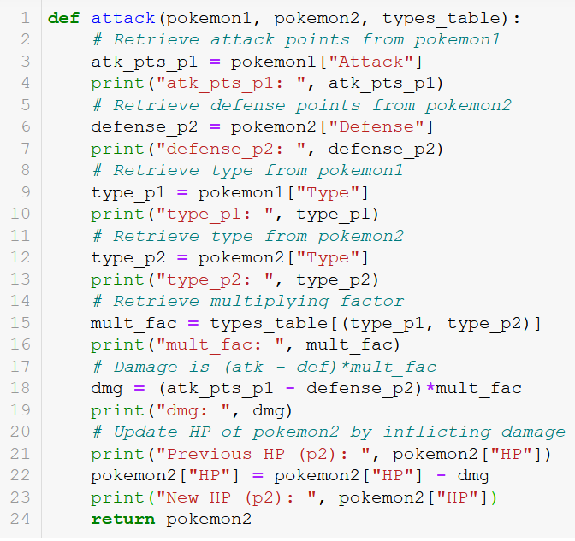

Slide 34
ATTACK! attack(pokemon1,
pokemon2,
types_table)

Slide 35
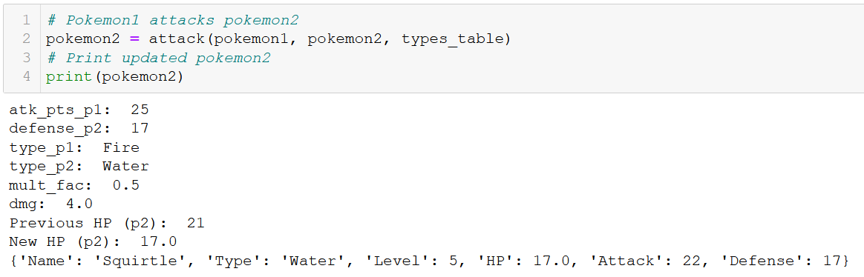
The attack function, at work

Slide 36
Going deeper
I believe that this example helped visualize how Object-Oriented Thinking can help improve the structure of your code!
You have seen here how it could be done using a dictionary. In practice however, OOP goes far deeper, and gives the possibility to create:
Your own custom types of variables, so that you can represent any object you want.
Your own custom methods, i.e. functions that will only apply to these custom objects.
We will learn more about the Object-Oriented Programming concepts in the next coming lecture!

Slide 37
Activity 3 - Hero stats
In OOP, a function, which creates an object and its dictionary, based on a few variables, is called a constructor function for the object.
In this activity, we design a constructor function for a hero object.
Write a function create_hero(), which receives three parameters:
str_pts: an int corresponding to the strength points of the hero,
agi_pts: an int corresponding to the agility points of the hero,
int_pts: an int corresponding to the intelligence points of the hero.

Slide 38
Activity 3 - Hero stats
It returns a dictionary containing the following keys and values:
str_pts: an int corresponding to the strength points of the hero,
agi_pts: an int corresponding to the agility points of the hero,
int_pts: an int corresponding to the intelligence points of the hero,
HP_pts: an int corresponding to the life points of the hero, which is 10 points, plus 10 times the number of strength points,
MP_pts: an int corresponding to the magic points (MP) of the hero, which is 5 times the number of intelligence points,
atk_pts: an int corresponding to the attack points of the hero, which is the sum of the strength, agility and intelligence points.

Slide 39
Activity 4 - Equipping a weapon
Let us consider the hero defined below as an object, with its own dictionary.
hero_dict = {'str_pts': 10, 'equipped_weapon': None, 'atk_pts': None}
Notice how no attack points and equipped weapon have yet been defined (they instead have the None value).
We can also define weapons objects, as dictionaries as well. Below we have defined two weapon objects: a sword and a bow.
sword = {"weapon_name": "Sword of Blazing Justice", "weapon_atk": 10}
bow = {"weapon_name": "Bow of Impeccable Accuracy", "weapon_atk": 8}

Slide 40
Activity 4 - Equipping a weapon
Write a function equip_weapon(), which receives two dictionaries:
The first one is a hero dictionary,
The second one is a weapon dictionary (either the sword or bow).
It will return the hero dictionary, whose keys, 'equipped_weapon' and 'atk_pts', have been updated.
The value assigned to the 'equipped_weapon' of the hero dictionary, will be the dictionary corresponding to the equipped weapon.
The value assigned to the 'atk_pts' of the hero dictionary, will consist of the hero strength points (in 'str_pts'), plus the weapon attack points (in the weapon dictionary, key 'weapon_atk').
Note: in practice, this OOP concept defines a 'has-a' relationship, because one of the attributes of the hero object is a weapon object.

Slide 41
Conclusion (Chapter 15)
What is the tuple type? (fast version)
What is the dictionary type?
What are typical operations on dictionaries?
How are dictionaries and the concept of object-oriented programming related?
What is “object-oriented thinking”?
Practice on dictionaries.
(If time allows, what is the set types?)

Slide 42



Please download and install the Slido app on all computers you use
What will be printed?
ⓘ Start presenting to display the poll results on this slide.

Slide 43
Please download and install the Slido app on all computers you use
Which operation should we use on line 2 to obtain ['gaming', 'running'] as a result on line 5?
ⓘ Start presenting to display the poll results on this slide.

Slide 44
Please download and install the Slido app on all computers you use
Which of the following checks if the key 'name' exists in the dictionary d?
ⓘ Start presenting to display the poll results on this slide.

Slide 45
Please download and install the Slido app on all computers you use
What will be the outcome of this code?
ⓘ Start presenting to display the poll results on this slide.

Slide 46
Please download and install the Slido app on all computers you use
Which of these four prints will display the string "gaming"?
ⓘ Start presenting to display the poll results on this slide.

